Slide 1
Trust and the market: Rethinking regulation

Slide 2
Rethinking regulation
Paul Philip
SRA Chief Executive

Slide 3
A Question of Trust
Crispin Passmore
SRA Executive Director Policy

Slide 4
Background
Why we did it
Engage public and profession in regulation
Test whether different types of people expect different standards and behaviours from lawyers
Need for consistency and legitimacy of decision-making
Decisions to be based on Board’s assessment of our regulatory objectives, tested against public expectations and professional norms
What we did
Collected views of over 5,000 people through a range of media eg an online survey, Twitter polls, live voting at events, postcard campaign and a formal consultation

Slide 5
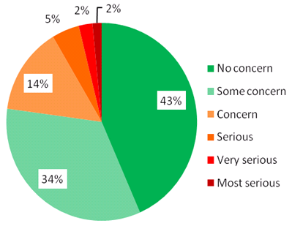
Intent influences seriousness
It is illegal to work as a solicitor without a practising certificate issued by the SRA. A typing mistake by a law firm leads to a solicitor unwittingly practising for 3 months without a current practising certificate. When the solicitor discovers the mistake she immediately takes steps to put the matter right.

Slide 6
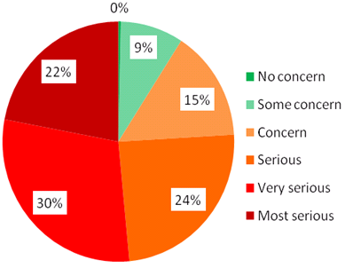
Intent influences seriousness
It is illegal to work as a solicitor without a practising certificate issued by the SRA. However, a solicitor knowingly continues to work after his
practising certificate has become out of date.

Slide 7
Client money
Misuse always very serious but public more sympathetic if money is replaced
Question | Solicitors | Non-solicitors
A senior solicitor in a law firm uses money that belongs to clients to pay his gambling debts. He says he always intended to pay the money back when his luck changed. | 5.9 – Most serious Less than 1% voted under 5 | 5.8 – Most serious 1% of people voted under 5
A solicitor uses money that belongs to clients, not the law firm itself, to solve cash-flow problems in his firm. | 5.8 – Most serious 3% of people voted under 5 | 5.5 – Most serious 6% of people voted under 5
A solicitor is holding money while a deceased client's will is being settled. The solicitor uses the money to pay her staff's wages. She returns the money before she is due to pay it to the deceased client's relations. | 5.5 – Most serious 7% of people voted under 5 | 4.9 – Very serious 23% of people voted under 5

Slide 8
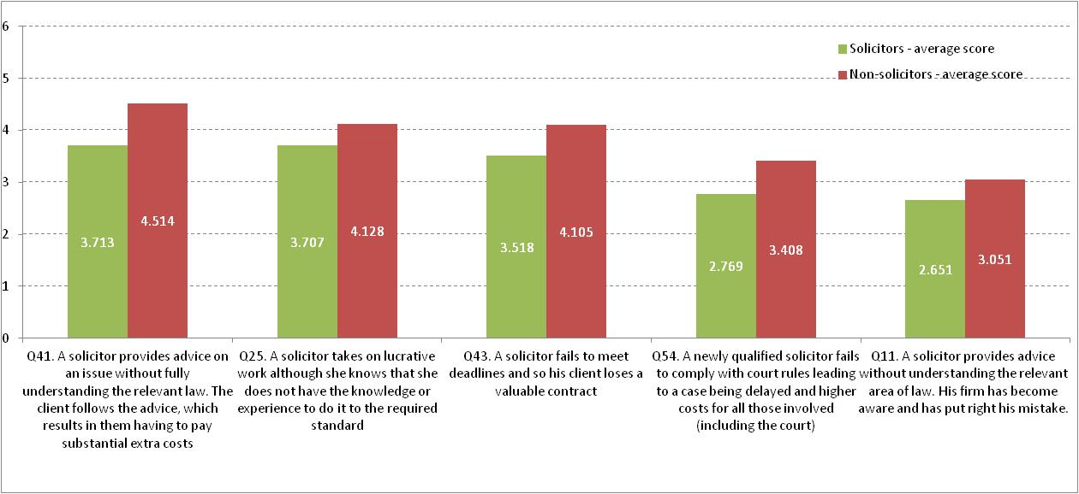
Solicitor competence
Q41. A solicitor provides advice on an issue without fully understanding the relevant law. The client follows the advice, which results in them having to pay substantial extra costs
Q25. A solicitor takes on lucrative work although she knows that she does not have knowledge or experience to do it to the required standard.
Q43. A solicitor fails to meet deadlines so his client loses a valuable contract.
Q54. A newly qualified solicitor fails to comply with court rules leading to a case being delayed and higher costs for those involved (including the court).
Q11. A solicitor provides advice without understanding the relevant area of law. His firm has become aware and has put right the mistake.
Solicitors – average score
Non- solicitors – average score

Slide 9
Confidentiality
Q20. A solicitor’s computer system is hacked, giving the hacker access to information about a private transaction. The investigation reveals the company’s security system was weak.
Q33. A train passenger can read confidential details about people’s health, finance and families on a solicitor’s laptop.
Q19. A client complains that each time he sees his solicitor there are other clients’ files open on the desk in the waiting area and no reception staff are present.
Q46. A woman is a witness in a child custody case. She complains that the solicitor who took her statement sent it by ordinary post to the wrong address, where it was opened by her neighbour. This embarrassed her.
Q45. A solicitor leaves files which include private information locked in the boot of his car. During the night the car is stolen and abandoned in a side street. When the car is found, the papers are still in the boot.
Solicitors – average score
Non- solicitors – average score

Slide 10
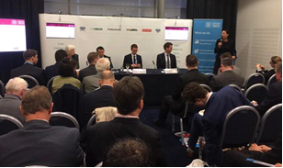
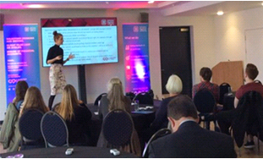
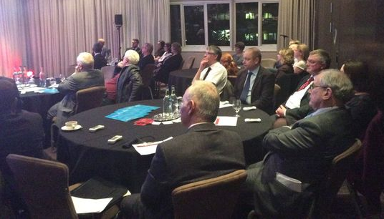
Conservative party conference fringe event
Some of our events
Members of the public in
Bristol
For more information
http://sra.org.uk/trust
Chester & N Wales
Law Society
Short background video available at https://www.youtube.com/watch?v=rFt3s1YlGlQ
Notes:
Webpage is sra.org.uk/trust
Had feedback from a RM firm who had attended a voting session: prompted by this and the client pressure research report, they intend to develop & roll out ethics training for their staff

Slide 11
The importance of trust
Ben Page
Ipso MORI Cheif Executive

Slide 12
Professionalism in practice
Panel discussion

Slide 13
Your panel
Simon Howard – Head of Professional Standard at the Architects Registration Board
Ben Page – Ipso MORI Cheif Executive
Crispin Passmore - SRA Executive Director Policy
Mike Petrook – Director of Communications and Corporate Affairs Institute of Customer Service
Hugh Simpson – Director of Strategy at the General Pharmaceutical Council
Caroline Wallace – Director of Strategy at the Legal Services Board

Slide 14
Trust and the market: Rethinking regulation

Slide 15
Breakout Sessions
Innovation: Trust in change - Euston room
Open data: The building blocks of trust - Stephenson room

Slide 16
Regulation in a modern marketplace
Chris Jenkins
Economics Director at the Competition and Markets Authority

Slide 17
Regulating the modern marketplace
Panel discussion

Slide 18
Your panel
Glyn Gaskarth - Head of Crime and Justice at Policy Exchange
Chris Jenkins - Economics Director at the Competition and Markets Authority
Dame Janet Paraskeva – Chair of the Council for Licensed Conveyancers
Paul Philip - SRA Chief Executive
Cathryn Ross – Chief Executive of Ofwat

Slide 19
Trust and the market: Rethinking regulation
Paul Philip
SRA Chief Executive

