Slide 1
Good lawyers making bad decisions: using risk-focused regulation to support the good and prevent the bad
DAY 1 – October 4th
11:00-12.30 hrs

Slide 2
International Conference of Legal Regulators October 4, 2018 “Good Lawyers Making Bad Decisions: Using Risk-focused Regulation to Support the Good and Prevent the Bad”
Panel: Victoria Rees, Nova Scotia Barristers’ Society, Canada
Hans Vogels, Limburg Bar, Netherlands
Juliet Oliver, Solicitors’ Regulation Authority, UK

Slide 3
Three main areas of different yet complimentary perspectives
What are common indicia of poor, incompetent and/or unethical client service?
What are some of the models or tools for proactively identifying and preventing incompetence & unethical conduct on the part of those we regulate?
How do we know whether these tools and models will be successful in supporting competent and ethical decision-making by those we regulate?

Slide 4
Solicitors Regulation Authority:
Who we are
Across England and Wales
we regulate:
We protect the public by:
Ensuring solicitors meet high standards through education and training
Taking action when things go wrong with a solicitor or firm
Making legal services more
accessible and affordable
Paying compensation to people
who have lost money
185,000 solicitors
10,500 firms
750

Slide 5
Risk based regulation
Reports to the SRA
Poor practice/
misconduct
Complaints received

Slide 6
A holistic approach
Supervisory investigations
Incoming reports
Market knowledge
Reviewing and compiling data
Reviewing/
collecting data
Thematic
investigations

Slide 7
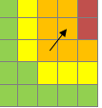
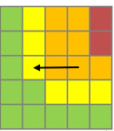
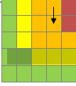
Proactive regulation based on risk
Regulatory Environment Dashboard
quarterly report featuring the top risks and issues affecting the market
identify issues, knowledge gaps and market developments
logs actions taken across directorates
helps the SRA to:
​​act only when it should, for no longer than is necessary
​​provide a consistent, transparent and ​disclosable account of our thinking.
Cybercrime
Holiday sickness claims
Money laundering

Slide 8
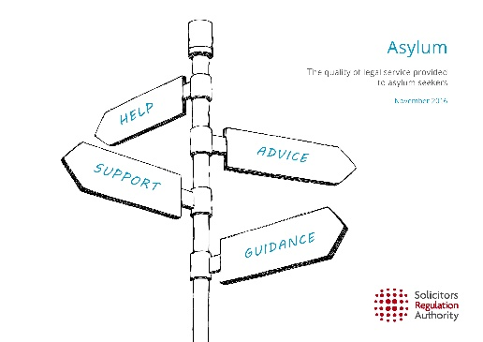
Thematic reviews
In-depth audits - at risk firms & random samples
Focus on improving standards and identifying serious breaches for investigation
Asylum and immigration
Criminal advocacy
Anti-money laundering

Slide 9
Our thematic review approach
+
+
Firm visits
Detailed analysis
Research

Slide 10
Using other organisations data
Actively sourcing information from:
The Government (MoJ, Land Registry)
Other regulators
(claims management etc)
The LSB
Judiciary and the police
Banks
Insurers

Slide 11
Risk Outlook
sets out our position on risk in the legal services market
shows the priorities to which we will allocate our resources
explains how we will control these risks and act in the public interest
help solicitors and firms manage risk.
Annual report: July
Spring and Autumn updates

Slide 12
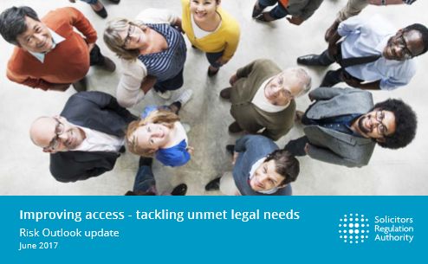
Risk Outlook
Topic papers
Focus on specific risks identified within the market
Provides guidance to firms on how to manage these risks

Slide 13
Common indicia of poor, incompetent and/or ethical client service
Male
Age 45-65
High standing in the community
100% reported violations of trust account rules on annual reports – most often including failure to prepare monthly trust account reconciliations, and overdrafts

Slide 14
Common indicia of poor, incompetent and/or ethical client service cont’d
80% had complaints history re quality of service and competence (delay, failure to communicate, failure to meet undertakings)
50% had reported civil judgments and bankruptcy
Most often in general practice, and either sole practitioners or in terms of three or fewer lawyers

Slide 15
Profile changes
Lawyers < 20 years at the Bar
Mental illness or addiction
Male and female
Smaller ‘thefts’ – i.e. ‘negligent misappropriation’

Slide 16
Financial Risks
Failure to maintain the required books, records and accounts in a timely and effective manner
Membership suspension for failure to pay fees or file trust account reports
Inability to meet expenses incurred in the course of the practice of law
Taxation decisions against the lawyer; i.e. a requirement to repay fees paid by clients

Slide 17
Financial Risks (cont’d)
Seeking loans from clients
Over-billing or other ‘unique’ fee arrangements
Over-working files to generate higher fees
Pre-taking unearned fees

Slide 18
Quality of Service Risks
Failure to return calls from clients, lawyers and others
Double-booking court appearances or not appearing at all
Court decisions finding incompetent counsel as a valid defence,
and/or ordering costs be paid by the lawyer personally
Failing to adhere to undertakings
Poor documentation of files

Slide 19
Quality of Service Risks (cont’d)
Protracted litigation where the reasonably foreseeable results are outweighed by the effort to reach the end
Failure to supervise staff or non-lawyers/abdication of practice to non-lawyers
Providing legal advice ‘on the fly’ before conducting any research of the facts and relevant law
Failing to conduct adequate or effective conflicts checks, and/or failing to identify a reasonably foreseeable conflict

Slide 20
Personal Risks
Evidence of mental health problems
Evidence of addictions
Becoming too emotionally involved in family law or child protective services matters
Criminal charges

Slide 21
What are the potential sources for these kinds of risk information?
Annual Lawyer Report
Annual or other Trust Account Reports
Trust audits and practice reviews
Ethics inquiries – ‘what do I do if…’
Complaints intake – calls from financial institutions and other professionals
Behaviour and results at the bar admission course and/or exams
Engagement with the accounting department; e.g. inability to pay fees on time, frequent changes of accounts
Information obtained through the reception desk or at the lawyers’ library

Slide 22
What are the potential sources for these kinds of risk information? (cont’d)
Reports from other lawyers from the community, committee volunteers
Newspapers and gossip sheets
Notice of judgements and bankruptcies
Law suits, taxation decisions, and professional indemnity insurance claims defences
Court decisions finding incompetent counsel or commenting on improper conduct of lawyers, whether in their personal or professional lives (including failure to make support payments)
Reports from judges through an appropriate protocol
Complaint responses/investigative interviews
Self-report

Slide 23
Tools for proactively identifying and preventing incompetent or unethical decision-making
Annual Lawyer Report
Annual or other Trust Account Reports
Trust audits and practice reviews
Process for responding quickly to inquiries about ethical and professional obligation, ethics, legal services/practice support

Slide 24
Tools for proactively identifying and preventing incompetent or unethical decision-making (cont’d)
Psychometrically defensible admissions criteria, assessments
Early resolution of complaints – help find solutions rather than blame; use a restorative justice approach
Education and articles about ethics, professionalism – drawing from actual examples
Fraud prevention and risk education initiatives

Slide 25
Tools for proactively identifying and preventing incompetent or unethical decision-making (cont’d)
Liaison with law schools about areas of weakness in substantive knowledge
Systems for third party reporting; e.g. financial institutions (ONP), judges
Fitness to Practice Programs; LAP, other diversionary and non-punitive alternatives
Triple P and risk-focused regulatory model

Slide 26
Tools for proactively identifying and preventing incompetent or unethical decision-making (cont’d)
Creative approaches to ethical and other regulatory violations – seek to change behaviour rather than punish
Follow-up surveys of the public and lawyers after interactions with the regulator – was the information helpful? Did it make a difference? If so, how? What else could we have done?
Post-mortems in cases of disbarment, misappropriation, serious misconduct – what did we know? When did we know it? What could we have done better/sooner? What tools or authority do we need that we didn’t have?
MSELP/AMS – SAT

Slide 27
Impact (risks) of size, type and culture of practices on competent and ethical decision-making
Sole practitioners
New lawyers
Small firms
Large firms
In house counsel

Slide 28
NSBS Responses
Legal Services Support team
MSELP and self-assessment
Working groups focused on solo and small firm issues and supports, government lawyers and in house counsel
New law firm registration process
Risk-focused questions on the Annual Lawyer Report and Annual Trust Account Report
Staff trained to provide practice and ethical guidance.
Changed the culture around our trust assurance program and audits

Slide 29
Regulatory Risk Management initiatives
Revising Risk Index
Capturing and recording potential risk information from all possible sources
Harvesting data as proactively as possible in order to better manage and respond to risk
Ensuring that Council and committees bring risk lens to all policy and decision making
Developing new 3-5 year Maturity Model for embedding the regulatory risk framework into all aspects of our work

Slide 30
Conclusion
20% increase in complaint calls, but a 20% decrease in written complaints
200+ calls to Legal Services Support team
Capturing and recording potential risk information from all possible sources
Law firms waived from submitting some reports for two years
Judges following protocol for reporting concerns
Fitness to Practice Program
MSELP pilot project

Slide 31
Risk-Based Approach: a theoretical model
Good morning!
Hans Vogels
President Limburg Bar, The Netherlands

Slide 32
Key info Netherlands’ Bar
17.672 registered lawyers
Protected title: “advocaat”
Automatic membership of:
National Bar (NOvA)
One of the 11 local (regional) Bars
Regions:
- Amsterdam 5.502
- Rotterdam 2.016
- Overijssel (smallest) 664
- Limburg (i.a. Maastricht) 770
(figures 1/1/2018)

Slide 33
Supervision
Local (= regional) Bar Presidents (11)
+ Staff 4,5 (7) / 20
+ Board
Access to the Bar
Funding by members
Local activities
Eyes & ears
Communicating
Supporting Bar President as supervisor
Regulation
NOvA (= national)
General Council
+ Staff
+ Representatives

Slide 34
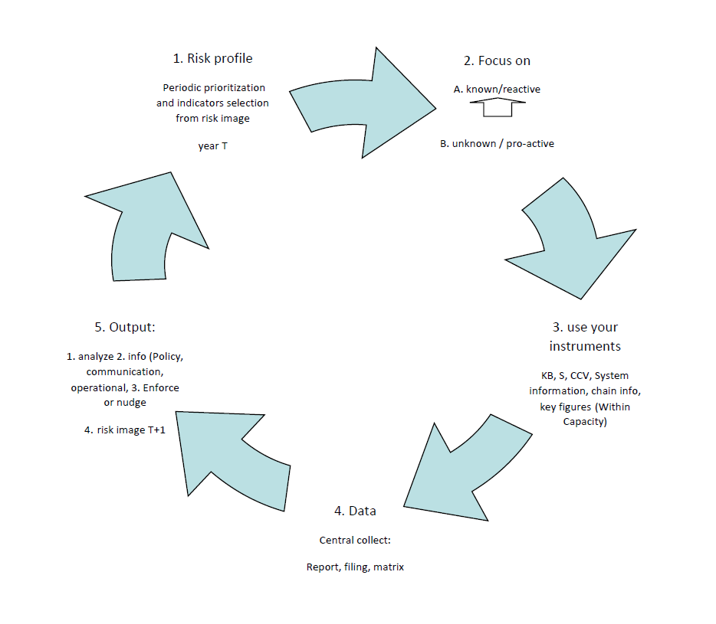

Slide 35
Example risk indicators map: dynamic < permanent input
Finance
Factoring/credit; delayed payment contributions etc.; negative solvability; delayed accounts; debts; structure; profit-based approach.
Ethics
Complaints; disciplinary sanctions; accountability third parties; trade register (remarks); addictions, other types of misconduct.
Quality
Small or monolithic portfolio; size of the firm; client satisfaction (matrix); disciplinary sanctions; insufficient permanent education.
Law practice / firm
Size of the firm; poor website; poor or no innovation; accounts; complaints; non- compliance to supervision

Slide 36
Example risk indicators map: dynamic < permanent input
Selection tool : formula CHANCE (big/small) x IMPACT (big/small)
Get smarter: the ultimate worldwide goal is to find the sole indicator.
The central focus is on quality and ethics: help keeping your sector in a good condition.

Slide 37
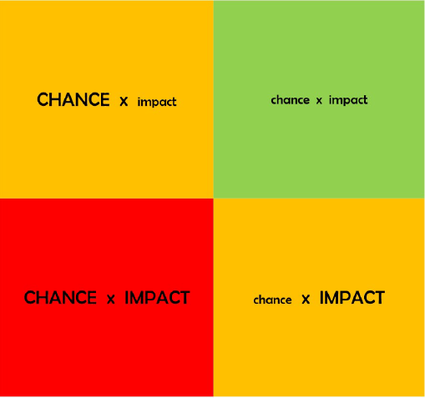
Tool: formula chance X impact

Slide 38
