Slide 1
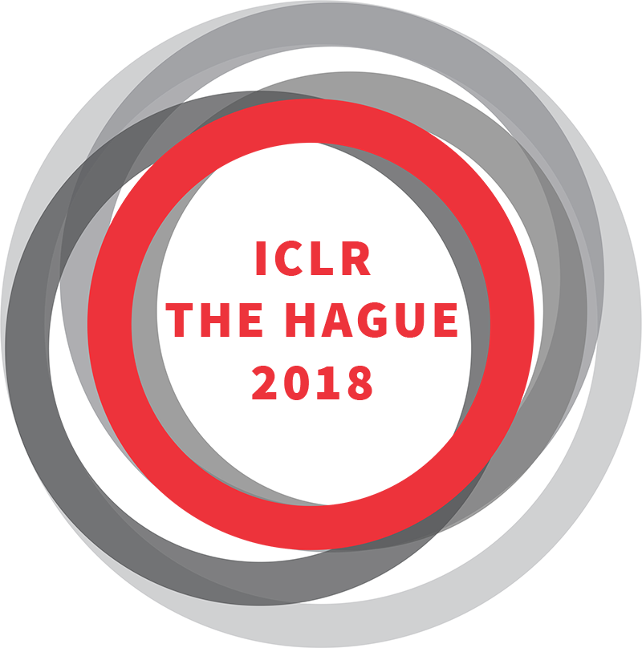
Impact of international lawyer organisations on regulation
DAY 1 – October 4th
13:30-15.00 hrs

Slide 2
Moderator
Leny de Groot-van Leeuwen (Radboud University)
Panelists
Ellyn Rosen (ABA)
Margarete von Galen (CCBE)
DAY 1 – October 4th
13:30-15.00 hrs

Slide 3
The impact of international lawyer organizations on regulation
Leny de Groot-van Leeuwen

Slide 4


insider outsider

Slide 5



The three organizations

Slide 6
International Bar Association (IBA)
Founded in 1947
Headquarters in London
80,000 individual lawyers, 25 corporate groups, 200 bar associations and law societies

Slide 7
Council of Bars and Law Socities of Europe (CCBE)
Founded in 1960
Headquarters in Brussels
Composed of lawyer organizations in 32 European countries with 11 associate/observer members

Slide 8
American Bar Association (ABA)
Founded in 1878
Headquarters in Chicago
Composed of 400.000 individual members

Slide 9
 | IBA | CCBE | ABA
Year founded | 1947 | 1960 | 1878
Membership | 199 lawyer associations, 100,000 individual lawyers, 25 corporate groups | 32 European Bar Associations (+13 associate/observers) representing more than 1 million European lawyers. | 400,000 individual members
Main Headquarters | London | Brussels (CCBE) | Chicago (ABA)
Annual Operating Income | £ 21.7 million (2016) | €2.3 million (2017) | $207 million ABA (2016)
Size of professional staff | About 80 staff | About 12 staff | 723 staff (ABA)

Slide 10

Objectives and mission of the three organizations
(1) To strengthen the legal profession
(2) To protect and promote the Rule of Law
(3) To protect and promote Human Rights
Motivation:
idealisme &
enlightened self-interest

Slide 11
Activities
Conferences
Codes, Principles and Guidelines for Conduct
Cross bordering practice
International arbitration
Human Rights
Assessments of justice systems
Reports
Recommendations
Directories
Training programs of lawyers, attorneys, judges etc.
Developing national, European, international institutions
Developing national, European International law

Slide 12
Operational objectives
Developing common rules of lawyering practice (hard law)
Building, defending and spreading principles of lawyering (soft law)
Protecting and promoting Human Rights

Slide 13
Overall Result
Overall result: Convergence of practices, rules, norms and values
Enabled by contextual factors:
Organizations share key values
Organizations collaborate and engage others
No world view/ideology alternative

Slide 14
Effectiveness
Important rules established and protected (hard law)
Many principles, codes of conduct, etc. established (soft law)
Many other actions (training, pro bono projects, etc. (very soft law)
In terms of substance, all these efforts follow the convergence route.
Downside of convergence: other voices marginalized

Slide 15
Efficiency
Looking from the outside, what do we see?
Nesting and overlapping organizations

Slide 16






NESTING ORGANIZATIONS
Norganizatins

Slide 17
Overlap
Membership: partly similar
Objectives: largely similar
Activities: largely similar
Countries addressed: partly similar, sometimes competition
Financial sources: partly similar, sometimes competition
Human resources (professional staff and volunteers) downside: elite circuit
And more:

Slide 18














Slide 19
Challenges or risks created by overlap
Demarcation problems
Dubious forumshopping of states
Dubious forumshopping of members
One world view:
exclusivism
distrust of the public

Slide 20
Questions to panelists and audience
Do you recognize the description of the organizations?
What is your own experience? Did the organizations help or hurt?
Is the land of lawyer organizations overpopulated? Suggestions?
How to organize the inclusion/exclusion of other voices?

Slide 21
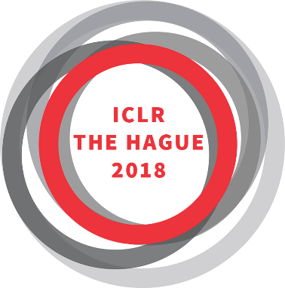
Presentation of Margarete Gräfin von Galen
Vice-President
Council of bars and Law Societies of Europe (CCBE)

Slide 22
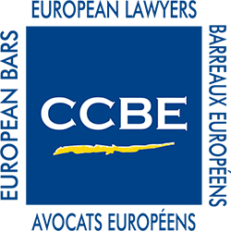



The Council of Bars and Law Societies of Europe
Represents European Bars and Law Societies in their common interests before European and other international institutions.
Liaison between its members and the European institutions, international organisations, and other legal organisations

Slide 23
The Council of Bars and Law Societies of Europe
Working Groups and Committees
Composed of experts appointed by the national delegations
Prepare policies, position papers
Analyse and provide expert views on legislative projects and other issues

Slide 24
Do the activities of the organisations have any tangible effect? Or are their actions all simply rhetoric?
The CCBE works in close cooperation with EU institutions:
  weekly contacts with Commission officials
  regularly providing information to Members of Parliament
  occasional contacts with European Council
  member of the e-Justice Working Party in the Council of Europe
  yearly meetings with the Court of Justice and General Court in Luxembourg
The institutions are receptive to our views for developing good policy.

Slide 25
Examples of accomplishments
The Cross-border Services Directive 77/249
The Establishment Directive 98/5, result of 18 years of CCBE involvement
Defense of citizens’ rights in areas such as on-line collection of evidence, surveillance, maintaining Lawyer Client confidentiality
Procedural safeguards for suspects and defendants in criminal proceedings: 6 Directives and development of further measures
Input to EU Policies – i.e. legal aid
Direct participation in EU Commission Expert groups
Active participation in projects which underpin policy development
[…]

Slide 26
Challenges and Focuses
Erosion of the Rule of Law within the EU
Threats for the independence of the profession and the Lawyer Client confidentiality as corner stones of the Rule of Law
Embrace new technologies and ensure that innovative tools
  do not negatively affect fundamental rights
  do not bypass important procedural safeguards

Slide 27
What happens when these organisations work in the same field and address the same issues?
The mission and core values of the profession are universal and are challenged by more and more issues with a global dimension.
The CCBE regularly cooperates with the ABA and IBA, to coordinate approaches, organise joint initiatives, address threats to the Rule of Law, start joint projects, etc.
Concrete and great example of a global effort and liaison:
CCBE, ABA and IBA Guide on “A Lawyer’s Guide to Detecting
and Preventing Money Laundering”, from October 2014

Slide 28
Lobbying for the Rule of Law
“Pure Bar” Association
Focusing on: role of lawyers and bars - in the public interest
  fair access to justice
  equality of rights
  legal certainty
As the Council of Europe, the CCBE values are:
Democracy, Human Rights and Rule of Law
At the heart of our activities: rights and interests of individual citizens

Slide 29

Thank you for your attention!
For more information: www.ccbe.eu
Follow us on @CCBEinfo

